Slide 1

ROBACH: Artificial Intelligence Generated baroque Music

Slide 2
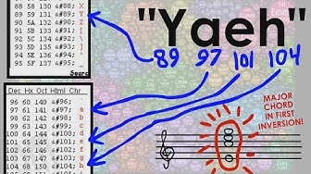
The Idea
Video Source

Slide 3
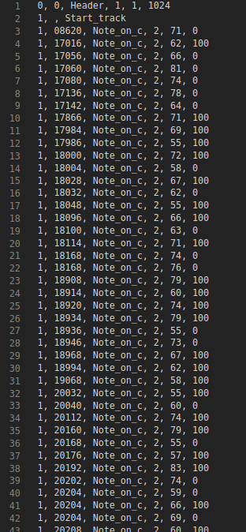
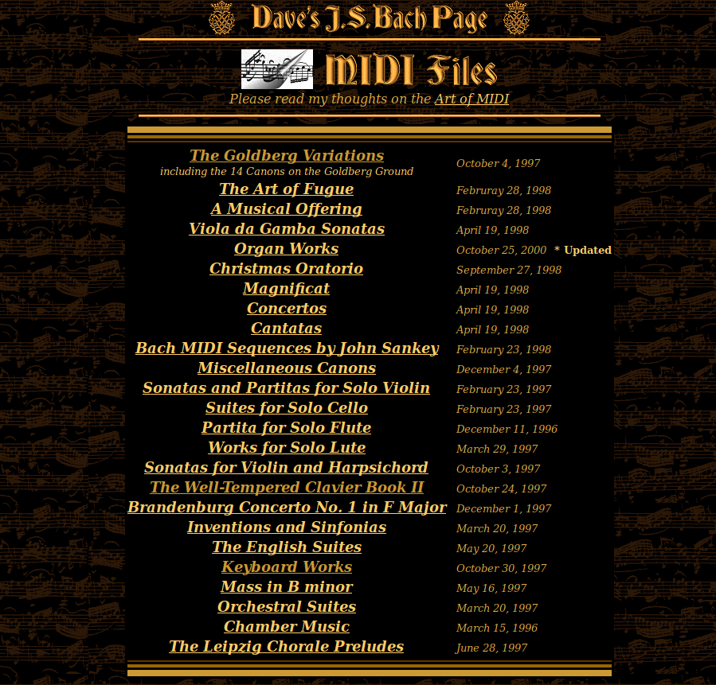
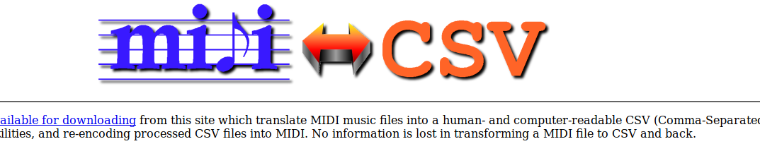
The Process

Slide 4
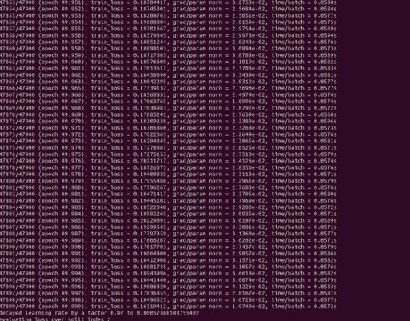
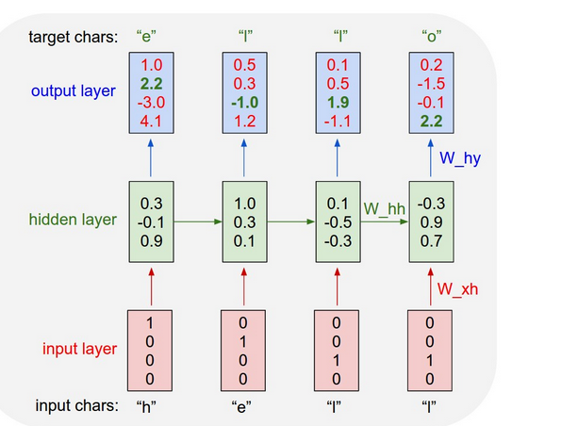
Training
Link To Blog Post Explaining how all of this

Slide 5
And the output?
The AI's Masterpiece

Slide 6
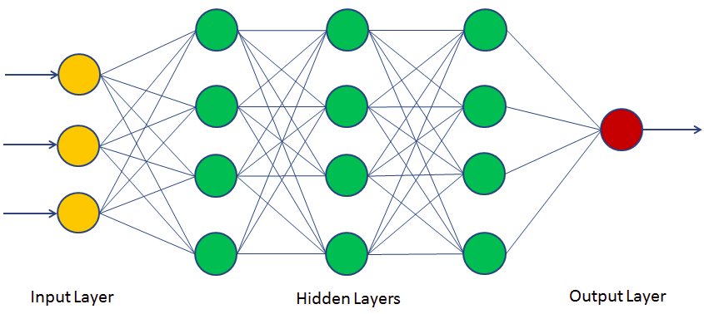
So Then... What went Wrong?
Dataset. Only used about 6 MB. Next time I need to use a lot more data.
Training time: The way the model is set, it does 50 Epochs and it depends on the time. Look into the docs to find how to adjust training time or number of epochs.
Adjust parameters to get a better fit. (RNN_Size and num_layers)

